Slide 1

Sai Srikar Lab-8

Slide 2
PANTONE® COLOUR OF THE YEAR 2022
import cv2
import numpy as np
img = cv2.imread('fingerprint.jpeg', 0)
# Taking a matrix of size 5 as the kernel
kernel = np.ones((5, 5), np.uint8)
img_erosion = cv2.erode(img, kernel, iterations=1)
img_dilation = cv2.dilate(img, kernel, iterations=1)
cv2.imshow('Input', img)
cv2.waitKey(0)
cv2.destroyAllWindows()
cv2.imshow('Erosion', img_erosion)
cv2.waitKey(0)
cv2.destroyAllWindows()
cv2.imshow('Dilation', img_dilation)
cv2.waitKey(0)
cv2.destroyAllWindows()

Slide 3
PANTONE® COLOUR OF THE YEAR 2022
opening = cv2.morphologyEx(img, cv2.MORPH_OPEN, kernel)
cv2.imshow('Opening', opening)
cv2.waitKey(0)
cv2.destroyAllWindows()
closing = cv2.morphologyEx(img, cv2.MORPH_CLOSE, kernel)
cv2.imshow('Closing', closing)
cv2.waitKey(0)
cv2.destroyAllWindows()

Slide 4
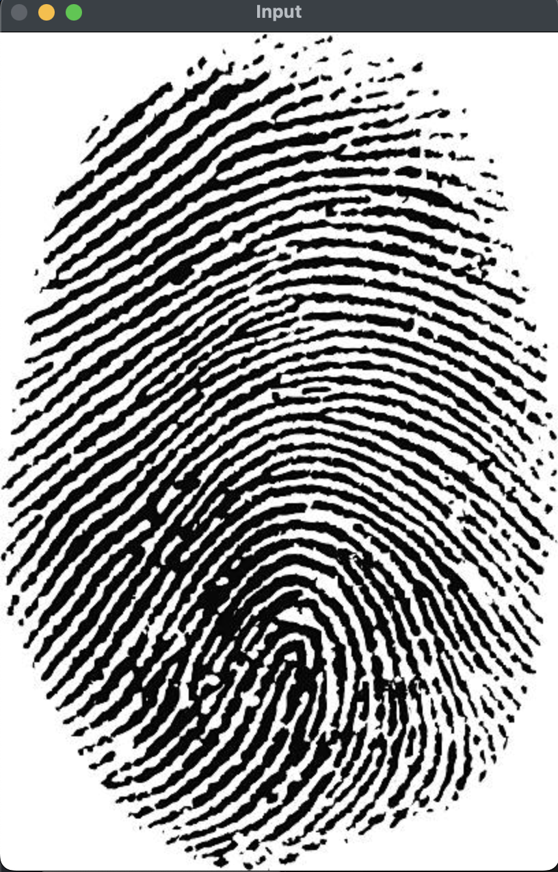
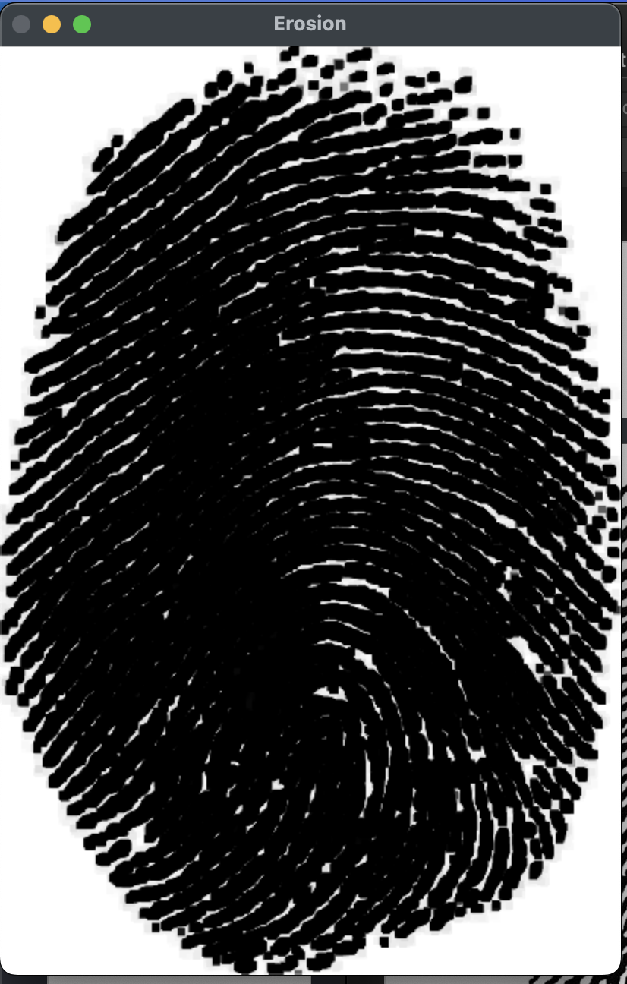
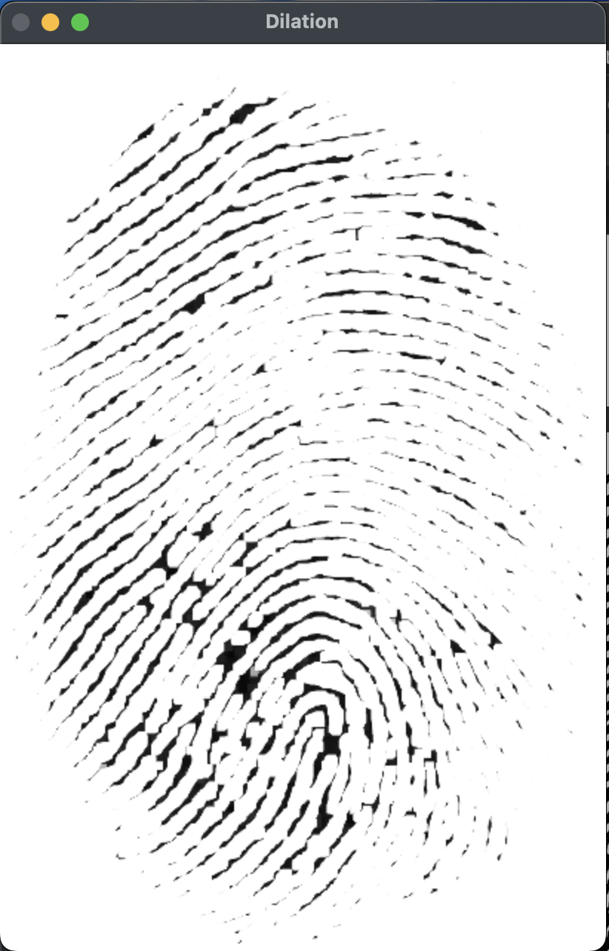
PANTONE® COLOUR OF THE YEAR 2022
OUTPUT-:

Slide 5
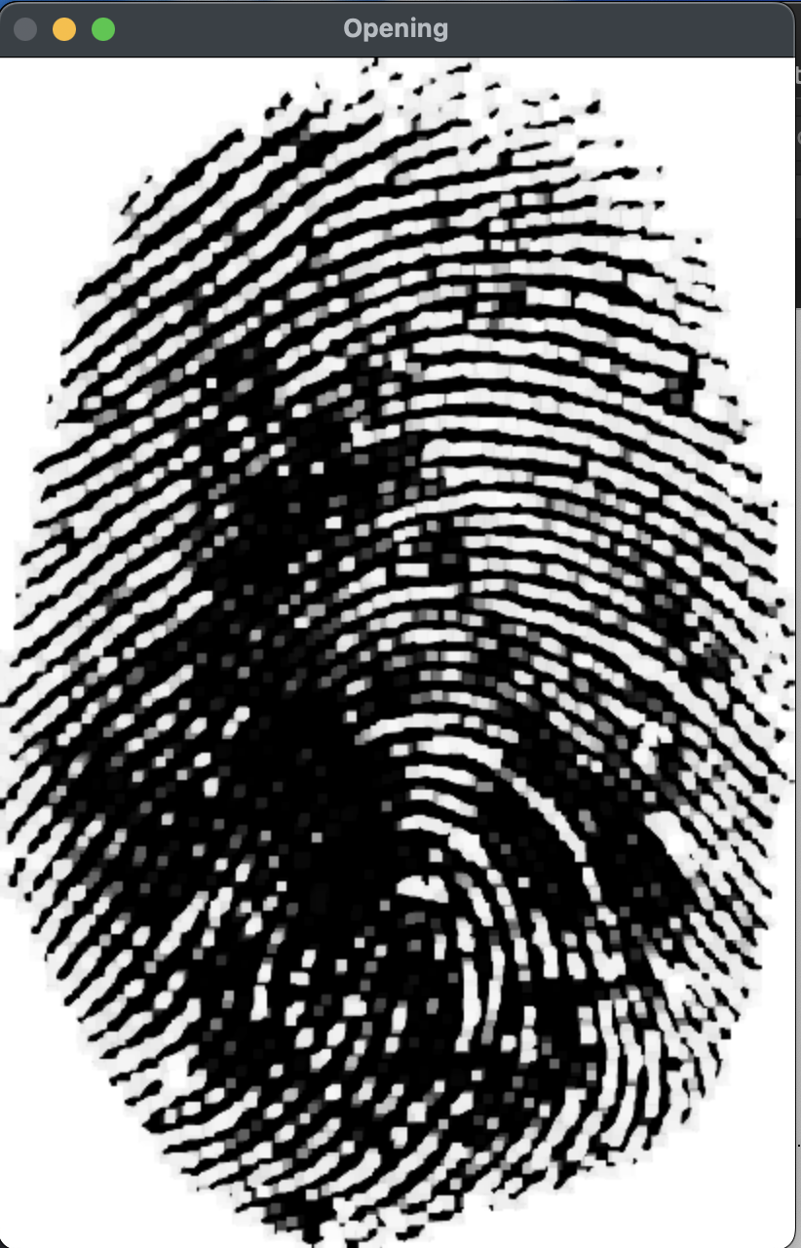
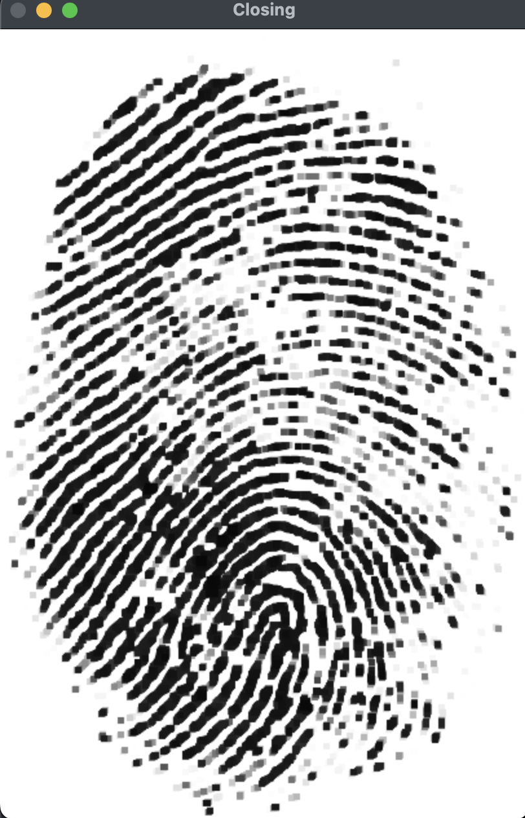
OUTPUT-:

Slide 6
import cv2
image = cv2.imread("wp3013104.jpeg")
new_image = image.copy()
gray = cv2.cvtColor(image, cv2.COLOR_BGR2GRAY)
cv2.imshow('Gray image', gray)
cv2.waitKey(0)
cv2.destroyAllWindows()
# Convert the grayscale image to binary
ret, binary = cv2.threshold(gray, 100, 255, cv2.THRESH_OTSU)
cv2.imshow('Binary image', binary)
cv2.waitKey(0)
cv2.destroyAllWindows()
# To detect object contours, we want a black background and a white
# foreground, so we invert the image (i.e. 255 - pixel value)
inverted_binary = ~binary
cv2.imshow('Inverted binary image', inverted_binary)
cv2.waitKey(0)
cv2.destroyAllWindows()
# Find the contours on the inverted binary image, and store them in a list
# Contours are drawn around white blobs.
# hierarchy variable contains info on the relationship between the contours

Slide 7
contours, hierarchy = cv2.findContours(inverted_binary,cv2.RETR_TREE,cv2.CHAIN_APPROX_SIMPLE)
# Draw the contours (in red) on the original image and display the result
# Input color code is in BGR (blue, green, red) format
# -1 means to draw all contours
with_contours = cv2.drawContours(image, contours, -1,(255,0,255),3)
cv2.imshow('Detected contours', with_contours)
cv2.waitKey(0)
cv2.destroyAllWindows()

Slide 8
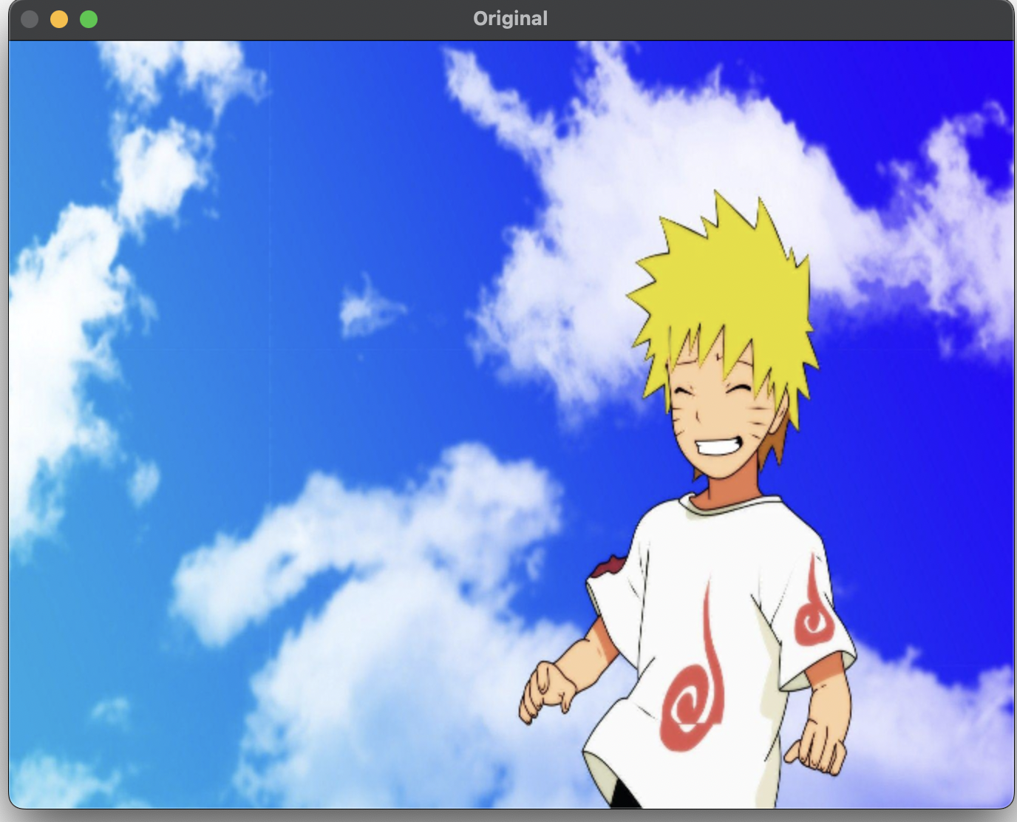
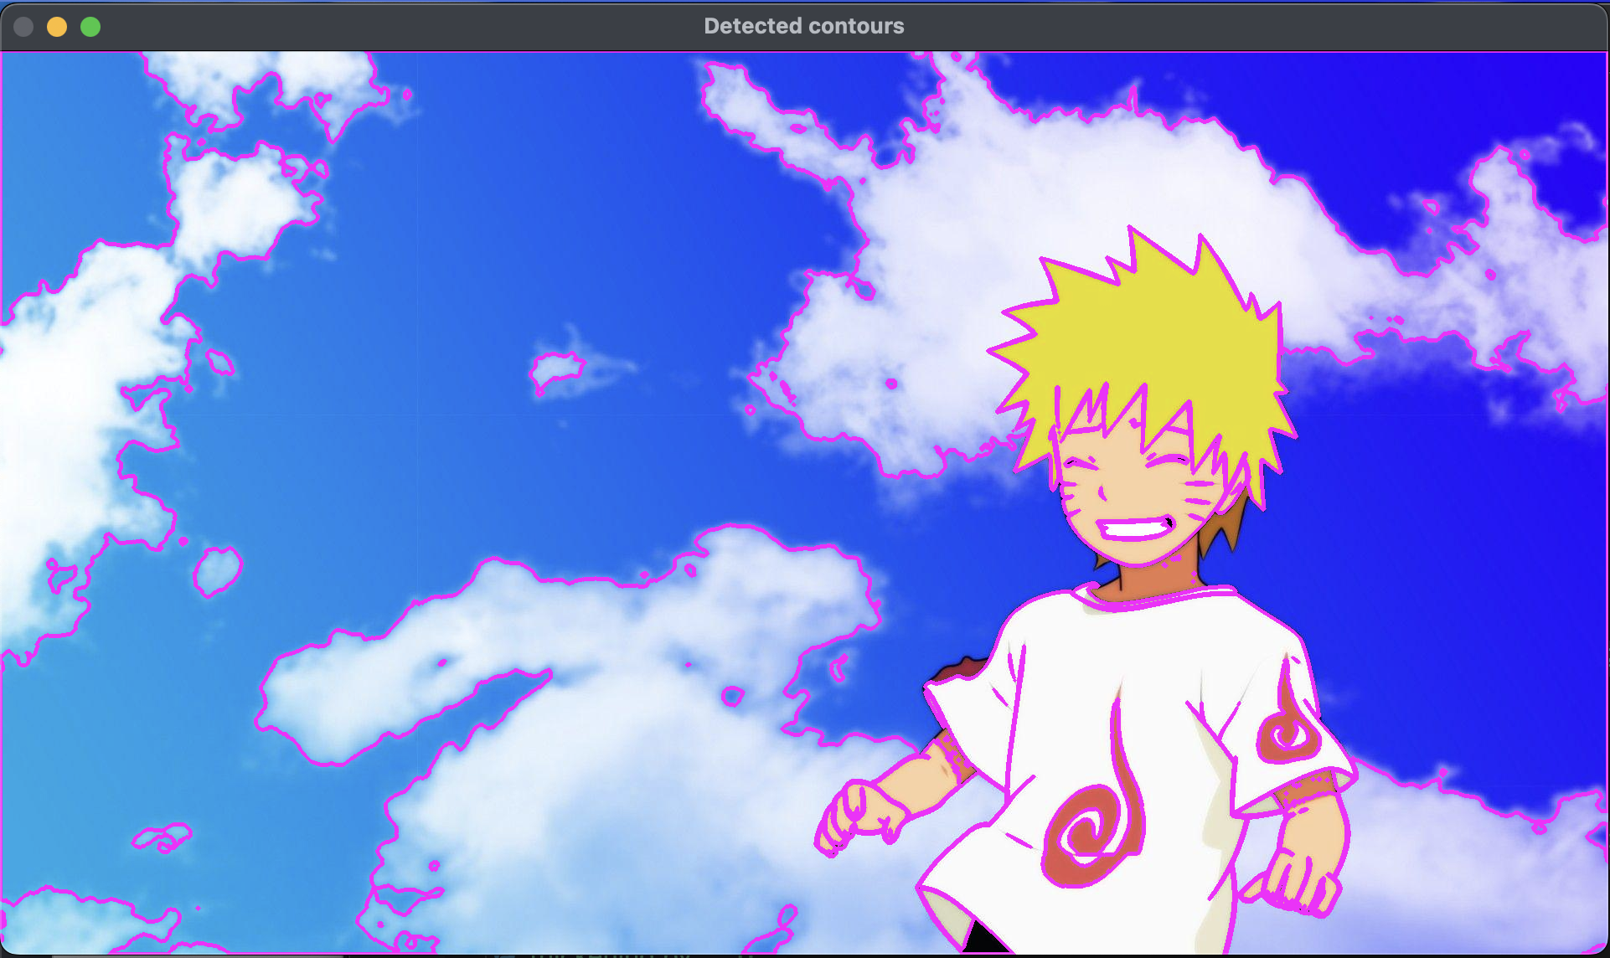
PANTONE® COLOUR OF THE YEAR 2022
OUTPUT-:

Slide 9
PANTONE® COLOUR OF THE YEAR 2022
import cv2 as cv
import numpy as np
input_image = np.array((
[225, 0, 0, 0, 0, 0, 0, 0],
[0, 255, 255, 255, 0, 0, 0, 255],
[0, 255, 255, 255, 0, 0, 0, 0],
[0, 255, 255, 255, 0, 255, 0, 0],
[0, 0, 255, 0, 0, 0, 0, 255],
[0, 0, 255, 0, 0, 255, 255, 0],
[0,255, 0, 255, 0, 0, 255, 0],
[0, 255, 255, 255, 0, 0, 0, 225]), dtype="uint8")
kernel = np.array((
[0, 1, 0],
[1, -0, 1],
[0, 1, 0]), dtype="int")
output_image = cv.morphologyEx(input_image, cv.MORPH_HITMISS, kernel)

Slide 10
PANTONE® COLOUR OF THE YEAR 2022
rate = 50
kernel = (kernel + 1) * 127
kernel = np.uint8(kernel)
kernel = cv.resize(kernel, None, fx = rate, fy = rate, interpolation = cv.INTER_NEAREST)
cv.imshow("kernel", kernel)
cv.moveWindow("kernel", 0, 0)
input_image = cv.resize(input_image, None, fx = rate, fy = rate, interpolation = cv.INTER_NEAREST)
cv.imshow("Original", input_image)
cv.moveWindow("Original", 0, 200)
output_image = cv.resize(output_image, None , fx = rate, fy = rate, interpolation = cv.INTER_NEAREST)
cv.imshow("Hit or Miss", output_image)
cv.moveWindow("Hit or Miss", 500, 200)
cv.waitKey(0)
cv.destroyAllWindows()

Slide 11
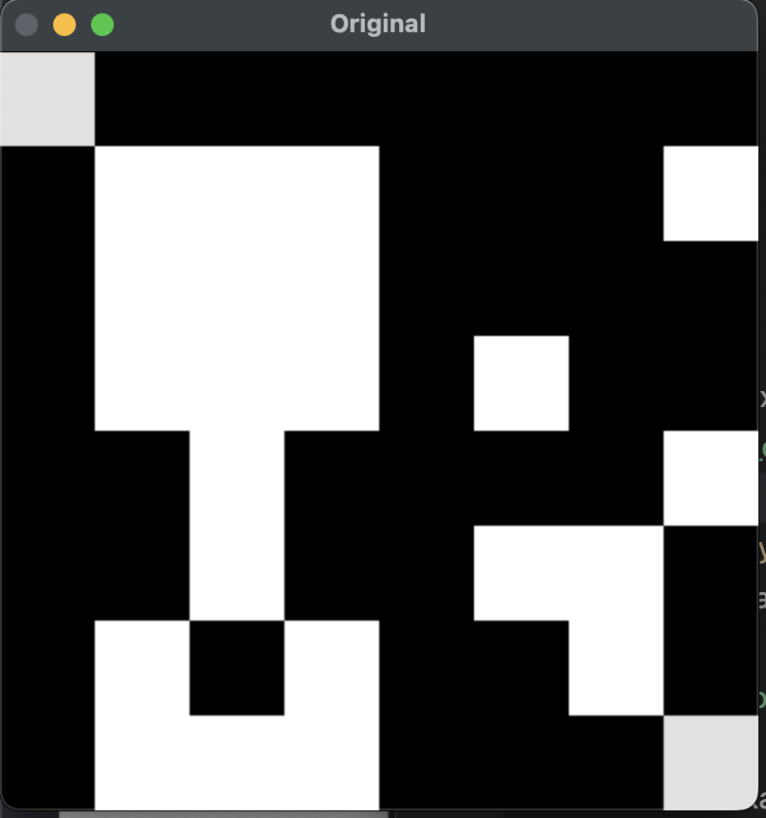
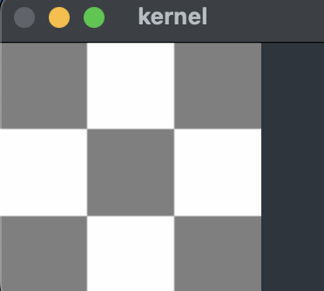
OUTPUT-:

Slide 12
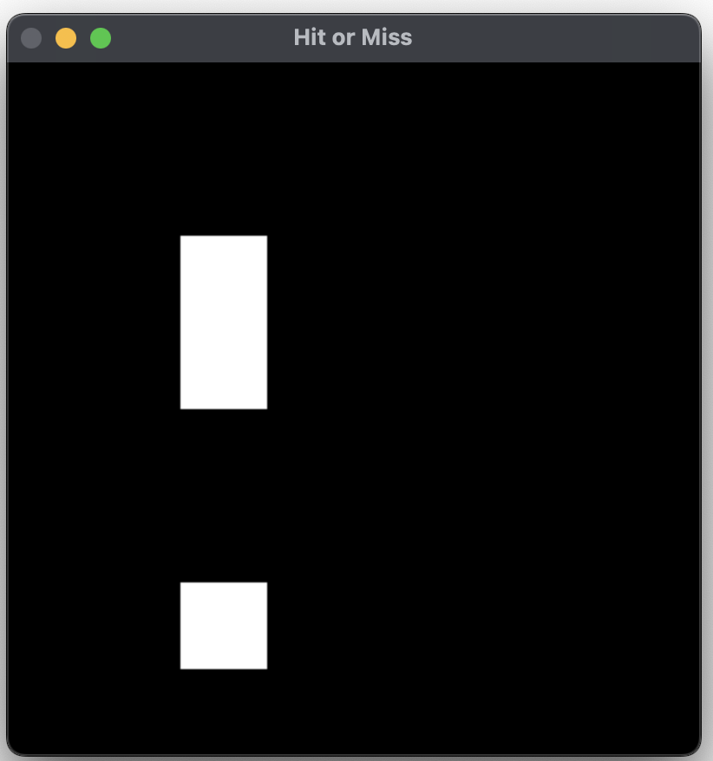
OUTPUT-:

Slide 13
PANTONE® COLOUR OF THE YEAR 2022
import cv2;
import numpy as np;
import matplotlib.pyplot as plt
im_in = cv2.imread("/Users/apple/Desktop/code/Digital_Image_processing/coins.jpeg", cv2.IMREAD_GRAYSCALE)
th, im_th = cv2.threshold(im_in, 220, 255, cv2.THRESH_BINARY_INV)
im_floodfill = im_th.copy()
h, w = im_th.shape[:2]
mask = np.zeros((h+2, w+2), np.uint8)
cv2.floodFill(im_floodfill, mask, (0,0), 255)
im_floodfill_inv = cv2.bitwise_not(im_floodfill)
im_out = im_th | im_floodfill_inv
plt.imshow(im_in)
plt.title('Original Image')
plt.show()
plt.imshow(im_floodfill)
plt.title('Floodfilled Image')
plt.show()

Slide 14
PANTONE® COLOUR OF THE YEAR 2022
plt.imshow(im_floodfill_inv)
plt.title('Inverted Floodfilled Image')
plt.show()
plt.imshow(im_out)
plt.title('Foreground')
plt.show()

Slide 15
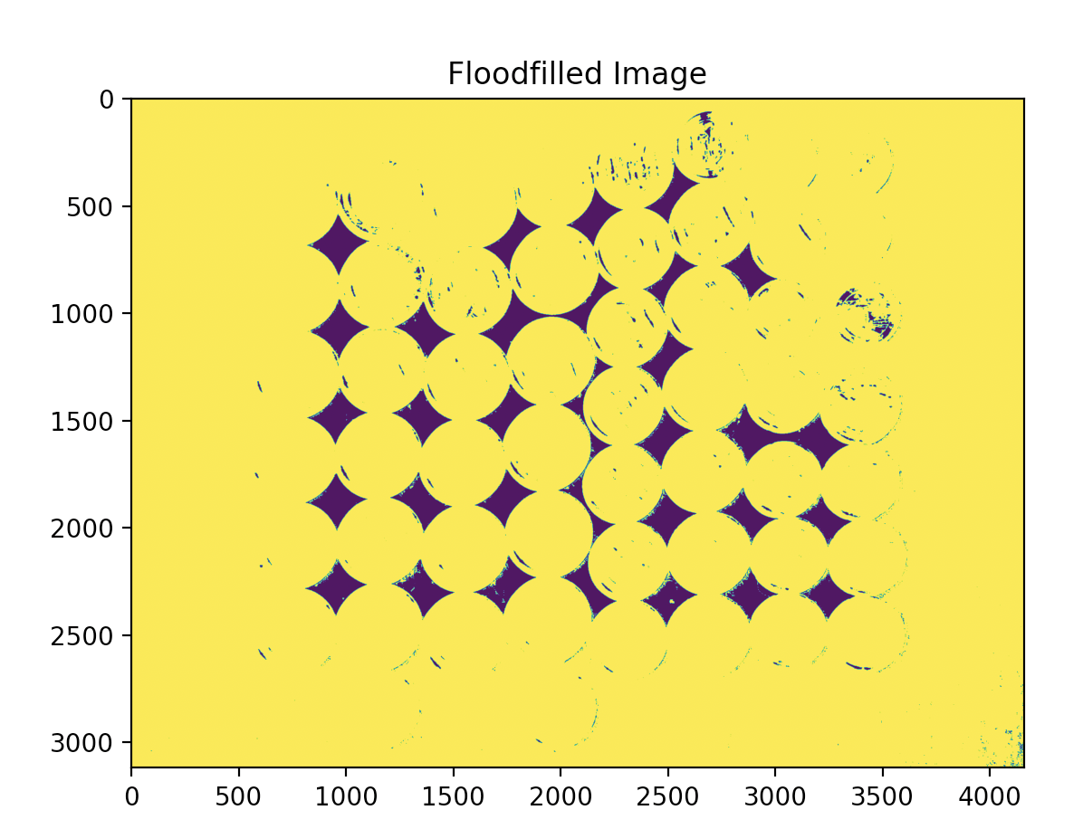
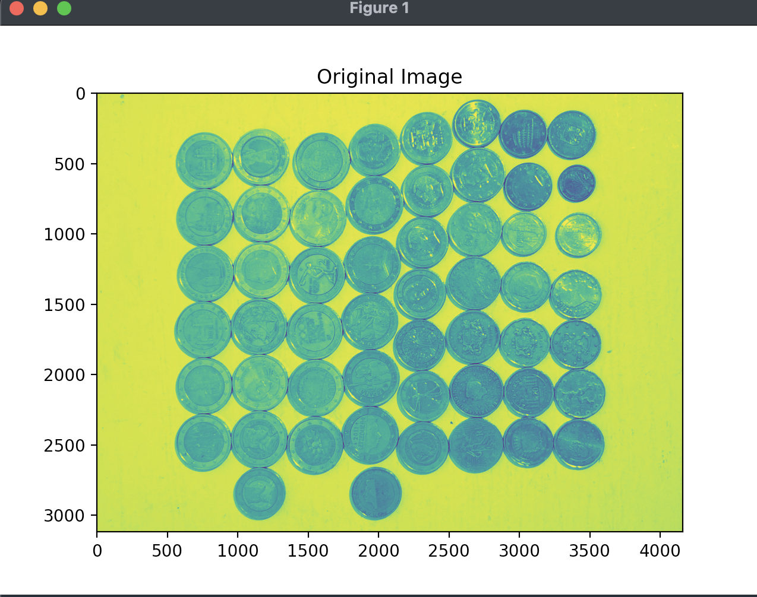
OUTPUT-:

Slide 16
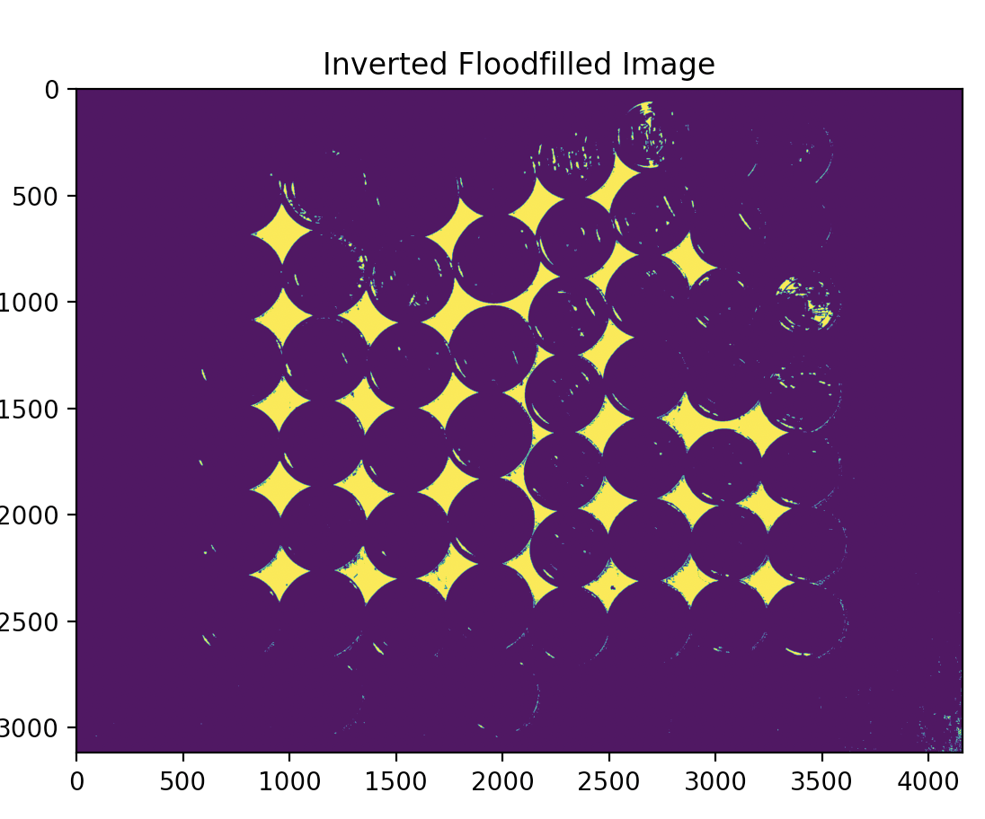
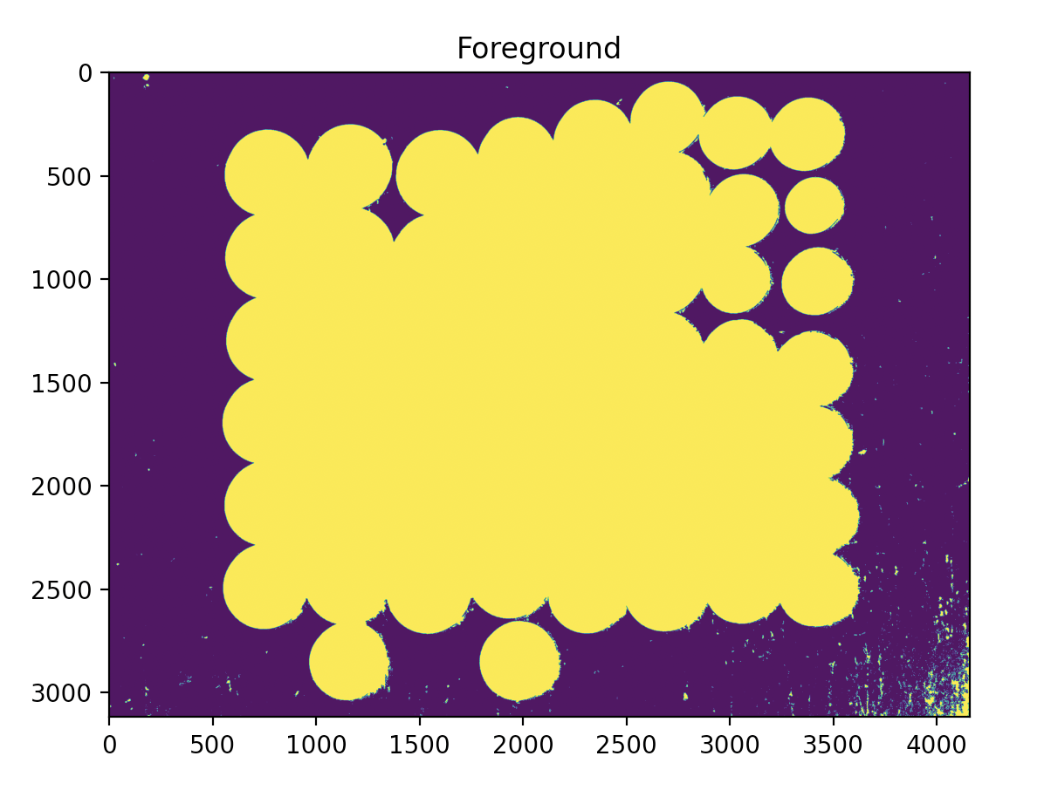
OUTPUT-:

Slide 17
PANTONE® COLOUR OF THE YEAR 2022
import cv2
import numpy as np
img = cv2.imread('galaxy.jpeg', 0)
cv2.imshow("Original Image",img)
cv2.waitKey(0)
cv2.destroyAllWindows()
img = cv2.threshold(img, 127, 255, cv2.THRESH_BINARY)[1] # ensure binary
num_labels, labels_im = cv2.connectedComponents(img)
def imshow_components(labels):
# Map component labels to hue val
label_hue = np.uint8(179*labels/np.max(labels))
blank_ch = 255*np.ones_like(label_hue)
labeled_img = cv2.merge([label_hue, blank_ch, blank_ch])

Slide 18
PANTONE® COLOUR OF THE YEAR 2022
# cvt to BGR for display
labeled_img = cv2.cvtColor(labeled_img, cv2.COLOR_HSV2BGR)
# set bg label to black
labeled_img[label_hue==0] = 0
cv2.imshow('labeled.png', labeled_img)
cv2.waitKey()
imshow_components(labels_im)

Slide 19
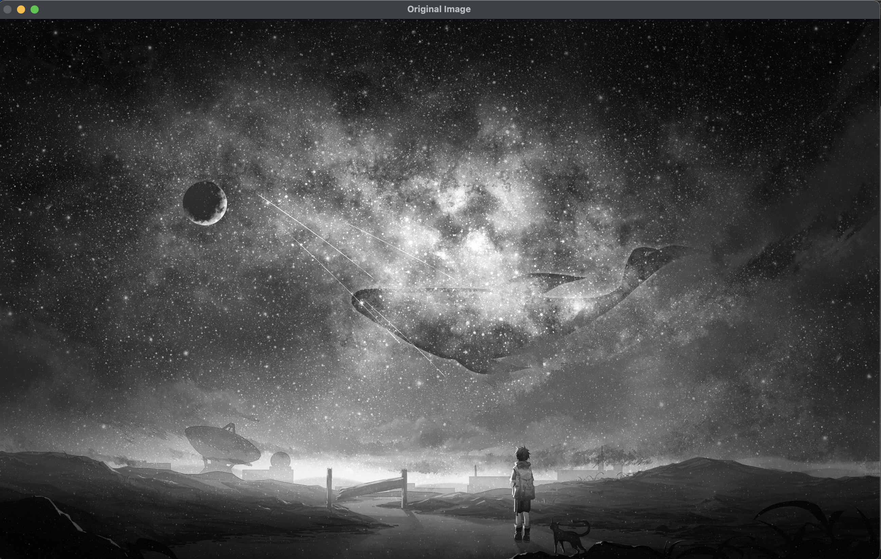
OUTPUT-:

Slide 20
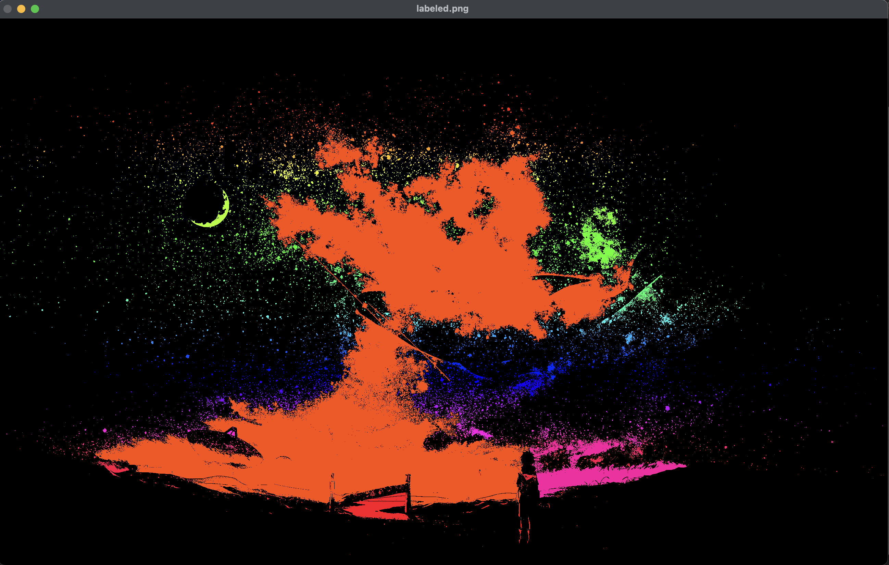
OUTPUT-:

Slide 21
PANTONE® COLOUR OF THE YEAR 2022
import cv2
import numpy as np
# Create an image with text on it
img = np.zeros((100,400),dtype='uint8')
font = cv2.FONT_HERSHEY_SIMPLEX
cv2.putText(img,'Thinning CV2',(5,70), font, 2,(255),5,cv2.LINE_AA)
img1 = img.copy()
# Structuring Element
kernel = cv2.getStructuringElement(cv2.MORPH_CROSS,(3,3))
# Create an empty output image to hold values
thin = np.zeros(img.shape,dtype='uint8')
# Loop until erosion leads to an empty set
while (cv2.countNonZero(img1)!=0):
# Erosion
erode = cv2.erode(img1,kernel)
# Opening on eroded image
opening = cv2.morphologyEx(erode,cv2.MORPH_OPEN,kernel)
# Subtract these two
subset = erode - opening

Slide 22
PANTONE® COLOUR OF THE YEAR 2022
# Union of all previous sets
thin = cv2.bitwise_or(subset,thin)
# Set the eroded image for next iteration
img1 = erode.copy()
cv2.imshow('original',img)
cv2.waitKey(0)
cv2.destroyAllWindows()
cv2.imshow('thinned',thin)
cv2.waitKey(0)
cv2.destroyAllWindows()

Slide 23
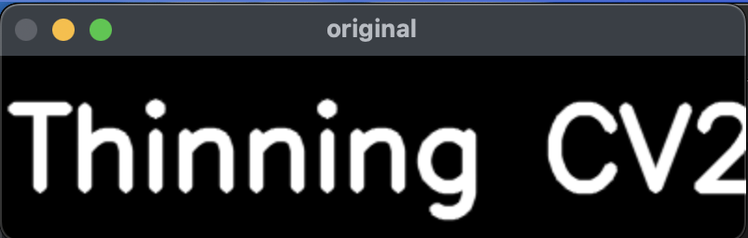
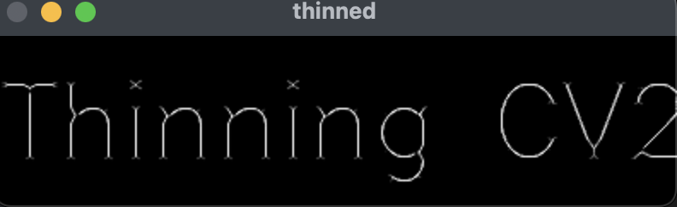
OUTPUT-:

Slide 24
PANTONE® COLOUR OF THE YEAR 2022
import cv2
import numpy as np
import matplotlib.pyplot as plt
mask = np.zeros((200,200,3), dtype=np.uint8)
cv2.line(mask, (50, 100), (150, 100), (255,255,255), 1)
kernel = cv2.getStructuringElement(cv2.MORPH_RECT, (3,3))
dilate = cv2.dilate(mask, kernel, iterations=5)
plt.imshow(mask)
plt.title('Original Line')
plt.show()
plt.imshow(dilate)
plt.title('Thickened Line')
plt.show()

Slide 25
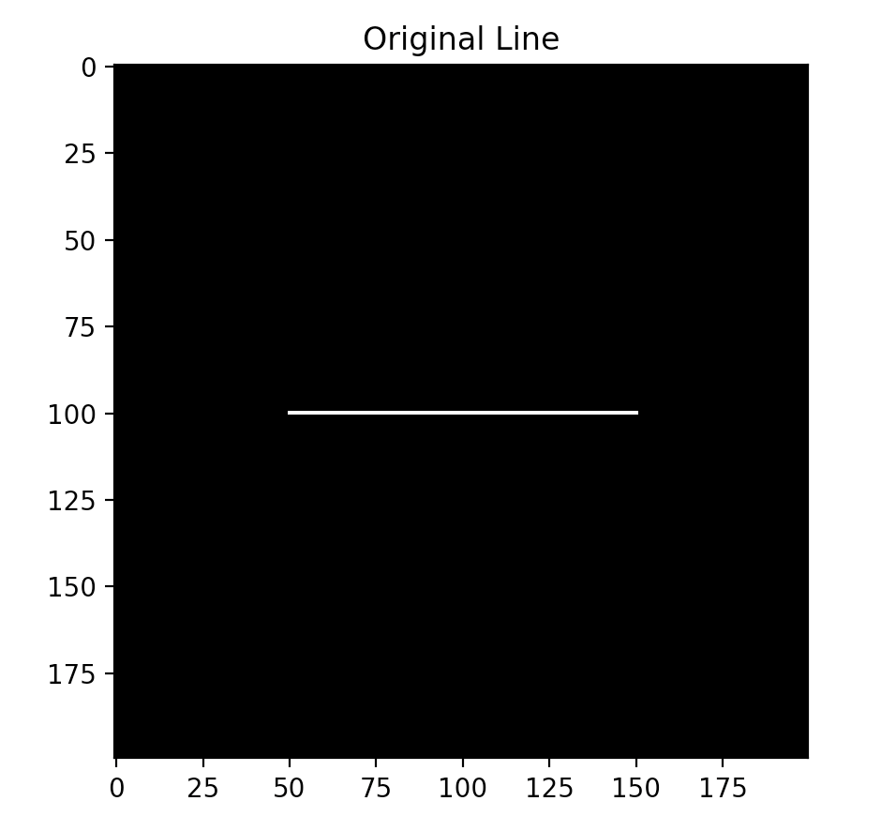
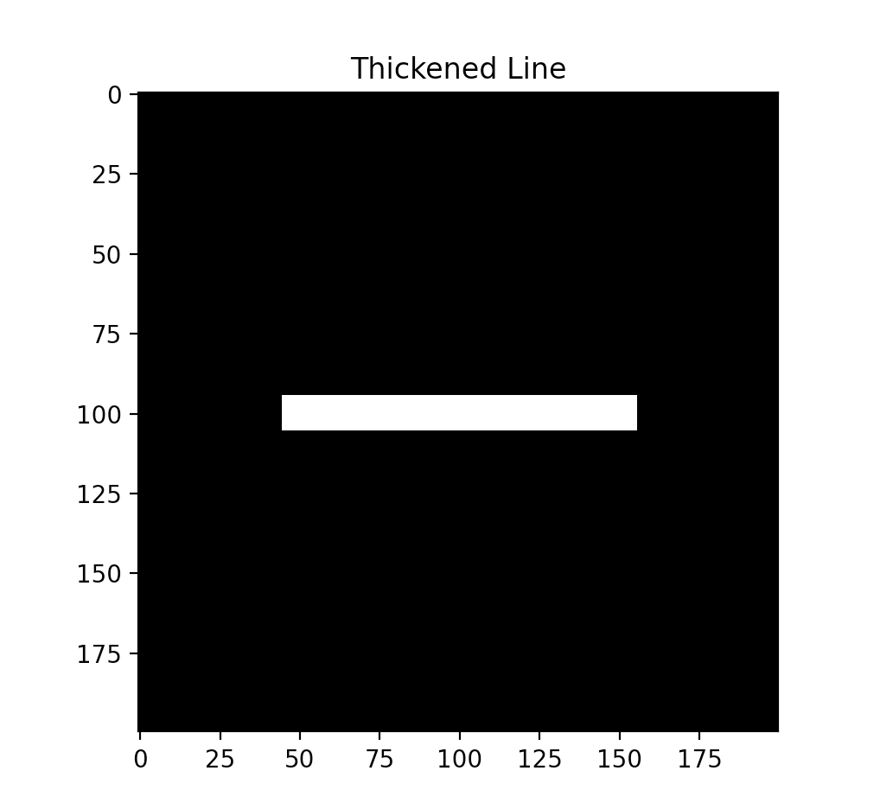
OUTPUT-:

Slide 26
PANTONE® COLOUR OF THE YEAR 2022
import cv2
import numpy as np
import matplotlib.pyplot as plt
img = cv2.imread("sunflower.jpeg",0)
cv2.imshow("Original Image",img)
cv2.waitKey(0)
cv2.destroyAllWindows()
ret,img = cv2.threshold(img, 127, 255, 0)
size = np.size(img)
skel = np.zeros(img.shape, np.uint8)
element = cv2.getStructuringElement(cv2.MORPH_CROSS, (3,3))

Slide 27
PANTONE® COLOUR OF THE YEAR 2022
while True:
open = cv2.morphologyEx(img, cv2.MORPH_OPEN, element)
temp = cv2.subtract(img, open)
eroded = cv2.erode(img, element)
skel = cv2.bitwise_or(skel,temp)
img = eroded.copy()
if cv2.countNonZero(img)==0:
break
plt.imshow(skel)
plt.title('Skeleton of Image')
plt.show()

Slide 28
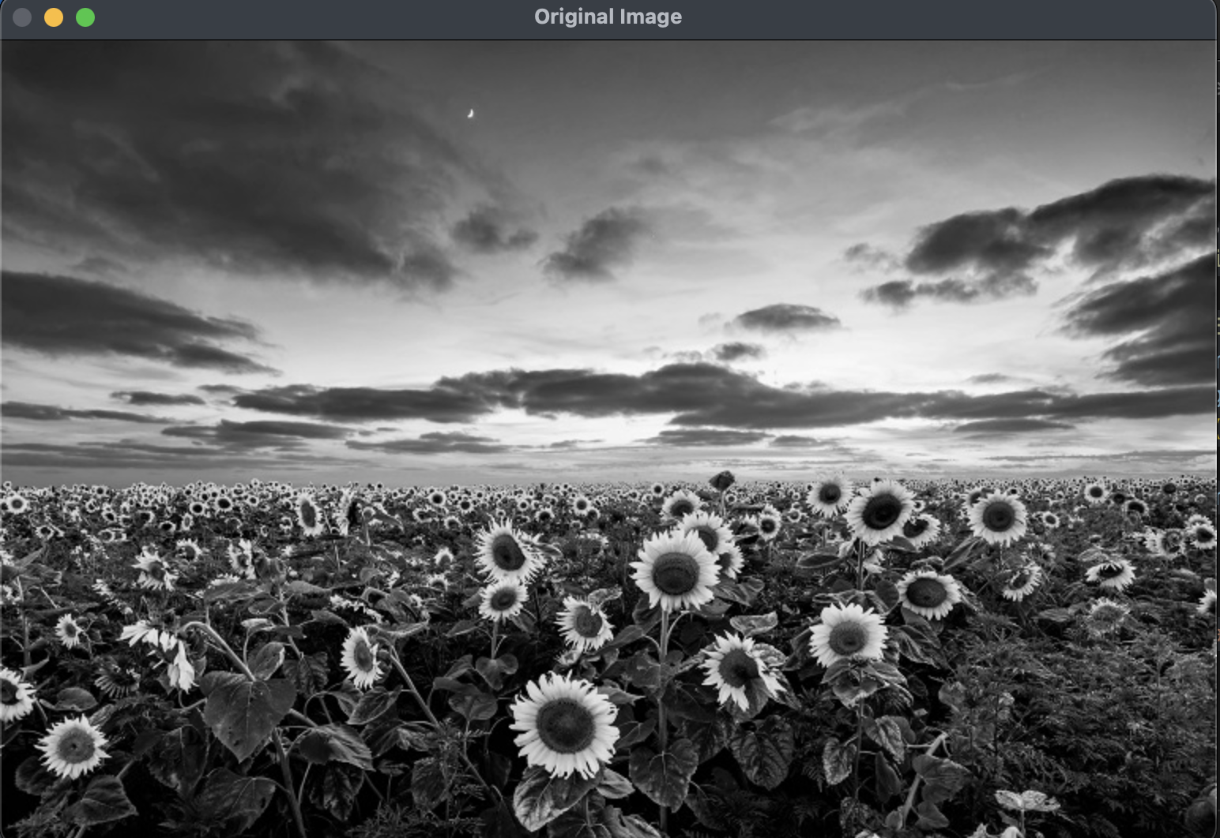
OUTPUT-:

Slide 29
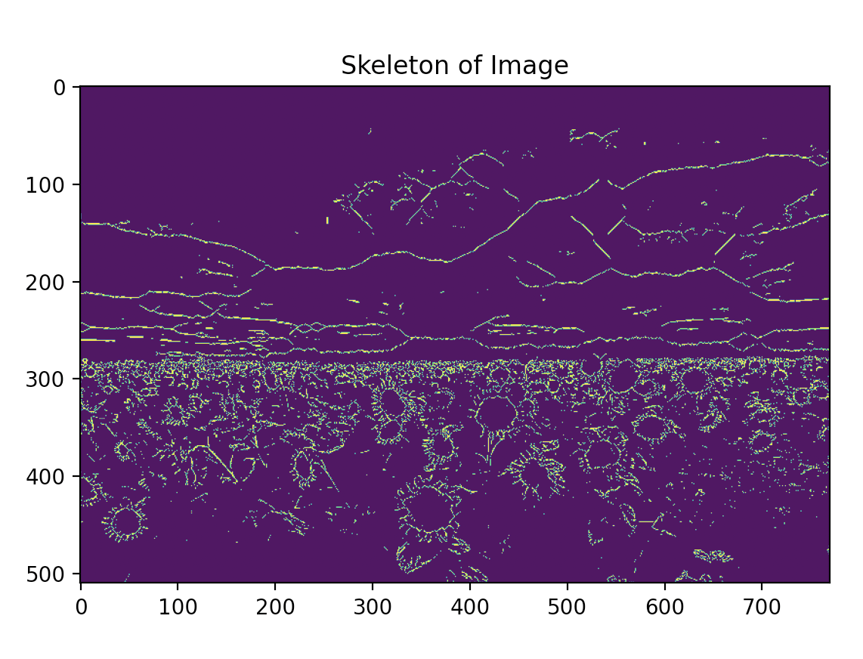
OUTPUT-:

Slide 30
THANK YOU You can find the code at -: https://github.com/Baka-14/Digital_Image_processing

